Slide 1

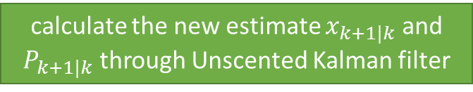
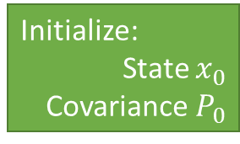
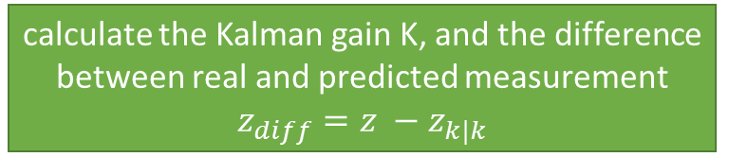
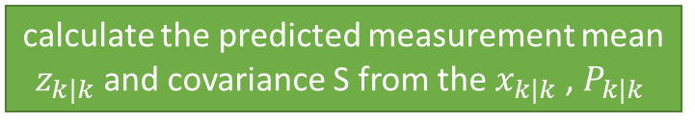
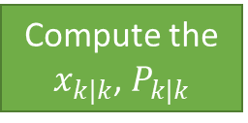
Create the UKF class and set the default parameters
Start
yes
First Measurement?
No
Step2: Predict
Data
Compute the augmented Mean $x_{aug}$ and Covariance $P_{aug}$
Compute elapsed time, △t
Compute the $x_{k|k}$, $P_{k|k}$
Data
Initialize:
State $x_{0}$
Covariance $P_{0}$
Laser or Radar?
Step3: Update
Step1: Initialization
Update Lidar/Radar measurement z
calculate the predicted measurement mean $z_{k|k}$and covariance S from the $x_{k|k}$, $P_{k|k}$
calculate the Kalman gain K, and the difference between real and predicted measurement
$$z_{diff}=z −z_{k|k}$$
calculate the new estimate $x_{k+1|k}$ and $P_{k+1|k}$ through Unscented Kalman filter

